Slide 1
Stack and Queue

Slide 2
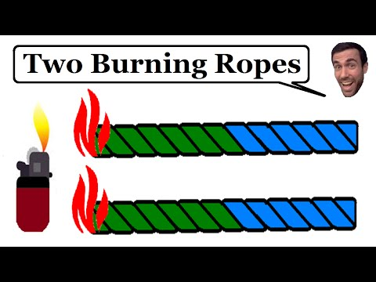
Brain Teaser!
You have two ropes. Each takes exactly 60 minutes to burn. They are made of different material so even though they take the same amount of time to burn, they burn at separate rates. In addition, each rope burns inconsistently. How do you measure out exactly 45 minutes?
(Asked in SAP labs,Expedia)

Slide 3
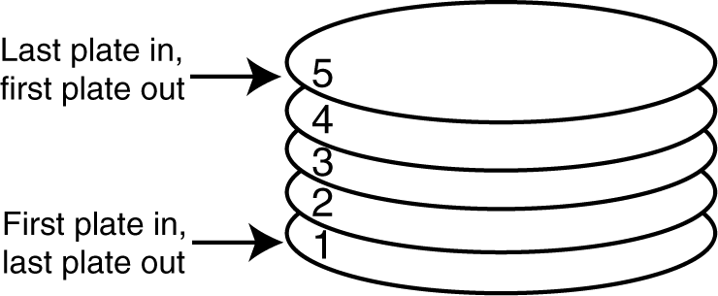
INTRODUCTION
A stack is a data structure that stores and retrieves items in a last-in-first-out (LIFO) manner.

Slide 4
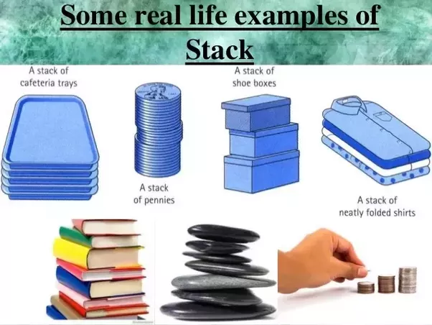

Slide 5
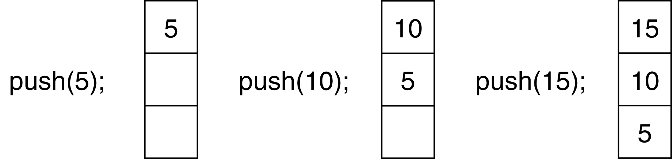
Stack Operations
Push
causes a value to be stored in (pushed onto) the stack
push(5);
push(10);
push(15);
The state of the stack after each of the push operations:

Slide 6
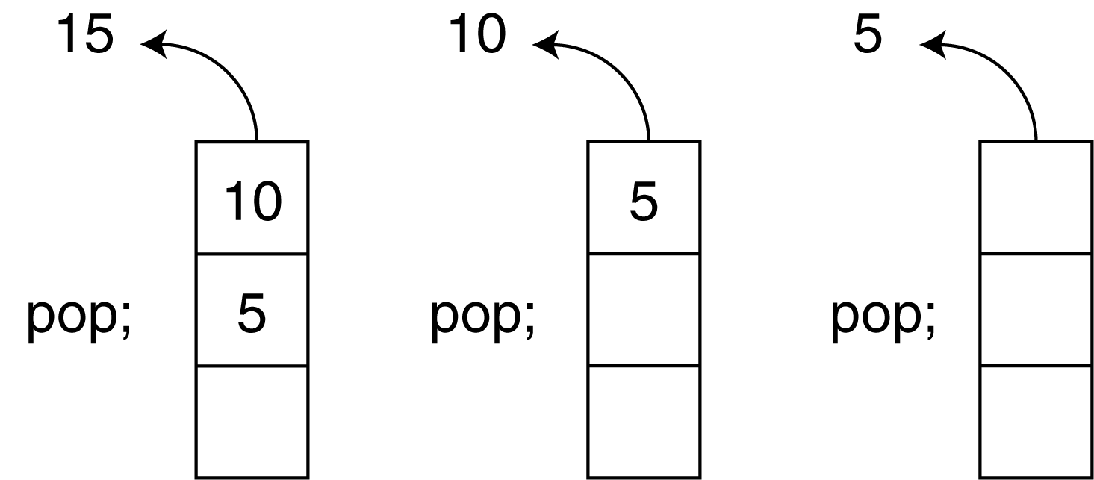
Pop
retrieves and removes a value from the stack
Now, suppose we execute three consecutive pop operations on the same stack:

Slide 7
Other Stack Operations
isFull: A Boolean operation needed for static stacks. Returns true if the stack is full. Otherwise, returns false.
isEmpty: A Boolean operation needed for all stacks. Returns true if the stack is empty. Otherwise, returns false.

Slide 8
Implementation of Stack:
There are two ways to implement a stack:
Using array
Using linked list

Slide 9
Implementing Stack using Arrays
#define MAX 1000
class Stack
{
int top;
public:
int a[MAX]; //Maximum size of Stack
Stack() { top = -1; }
bool push(int x);
int pop();
bool isEmpty();
};
bool Stack::push(int x)
{
if (top >= MAX)
{
cout << "Stack Overflow";
return false;
}
else
{
a[++top] = x;
return true;
}
}

Slide 10
int Stack::pop()
{
if (top < 0)
{
cout << "Stack Underflow";
return 0;
}
else
{
int x = a[top--];
return x;
}
}
bool Stack::isEmpty()
{
return (top < 0);
}
// Driver program to test above functions
int main()
{
struct Stack s;
s.push(10);
s.push(20);
s.push(30);
cout << s.pop() << " Popped from stack\n";
return 0;
}

Slide 11
Implementing Stack using Linked List(will be covered after linkedlist)
// A structure to represent a stack
struct StackNode
{
int data;
struct StackNode* next;
};
struct StackNode* newNode(int data)
{
struct StackNode* stackNode =
(struct StackNode*) malloc(sizeof(struct StackNode));
stackNode->data = data;
stackNode->next = NULL;
return stackNode;
}
int isEmpty(struct StackNode *root)
{
return !root;
}
void push(struct StackNode** root, int data)
{
struct StackNode* stackNode = newNode(data);
stackNode->next = *root;
*root = stackNode;
printf("%d pushed to stack\n", data);
}

Slide 12
int pop(struct StackNode** root)
{
if (isEmpty(*root))
return INT_MIN;
struct StackNode* temp = *root;
*root = (*root)->next;
int popped = temp->data;
free(temp);
return popped;
}
int peek(struct StackNode* root)
{
if (isEmpty(root))
return INT_MIN;
return root->data;
}
int main()
{
struct StackNode* root = NULL;
push(&root, 10);
push(&root, 20);
push(&root, 30);
printf("%d popped from stack\n", pop(&root));
printf("Top element is %d\n", peek(root));
return 0;
}

Slide 13
STL(Standard Template Library) is used for solving stack questions.
There is an already implemented class of stacks. We just need to include that class, create an object of class and use the class functions directly.
#include<stack>
int main(){
stack s;
s.push(5);
s.push(6);
int temp=s.top();
s.pop();
bool ans=s.isEmpty();
bool ans1=s.isFull();
}

Slide 14
Question 1: Check for balanced parentheses in an expression
Given an expression string exp , write a program to examine whether the pairs and the orders of “{“,”}”,”(“,”)”,”[“,”]” are correct in exp. For example, the program should print true for exp = “[()]{}{[()()]()}” and false for exp = “[(])”
Question 2: Given a string mathematical expression, return true if redundant brackets are present in the expression. Brackets are redundant if there is nothing inside the bracket or more than one pair of brackets are present. Example, for string=((a + b)) return true and for string=(a+b) return false.
Question 3: Reverse a given Stack with the help of another empty stack. Two stacks will be given. Out of which first contains some integers and second one is empty. You need to reverse the first one using second stack. Change in the given first stack itself.(Hint- Use Recursion)
Question 4: Given a stack, sort the elements inside that stack in ascending order using only push and pop operation. You can use one additional stack only.

Slide 15
Question:Prefix to Postfix Conversion
Prefix : An expression is called the prefix expression if the operator appears in the expression before the operands. Simply of the form (operator operand1 operand2).
Example : *+AB-CD (Infix : (A+B) * (C-D) )
Postfix: An expression is called the postfix expression if the operator appears in the expression after the operands. Simply of the form (operand1 operand2 operator).
Example : AB+CD-* (Infix : (A+B * (C-D) )

Slide 16
Algorithm for Prefix to Postfix:
Read the Prefix expression in reverse order (from right to left)
If the symbol is an operand, then push it onto the Stack
If the symbol is an operator, then pop two operands from the Stack
Create a string by concatenating the two operands and the operator after them.
string = operand1 + operand2 + operator
And push the resultant string back to Stack
Repeat the above steps until end of Prefix expression.

Slide 17
QUEUE: INTRODUCTION
Like Stack, Queue is a linear structure which follows a particular order in which the operations are performed. The order is First In First Out (FIFO). A good example of queue is any queue of consumers for a resource where the consumer that came first is served first.
The difference between stacks and queues is in removing. In a stack we remove the item the most recently added; in a queue, we remove the item the least recently added.

Slide 18
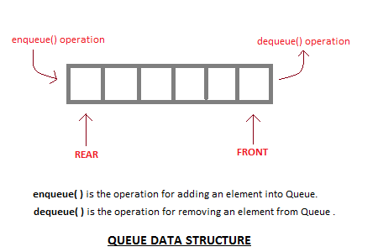
Operations on Queue: Mainly the following four basic operations are performed on queue: Enqueue: Adds an item to the queue. If the queue is full, then it is said to be an Overflow condition. Dequeue: Removes an item from the queue. The items are popped in the same order in which they are pushed. If the queue is empty, then it is said to be an Underflow condition. Front: Get the front item from queue. Rear: Get the last item from queue.

Slide 19
Implementation of Queue
Using:
Array
LinkedList
Similar to stack,we use STL for solving queue questions.

Slide 20
Priority Queue:
Priority Queue is an extension of queue with following properties.
1) Every item has a priority associated with it.
2) An element with high priority is dequeued before an element with low priority.
3) If two elements have the same priority, they are served according to their order in the queue.

Slide 21
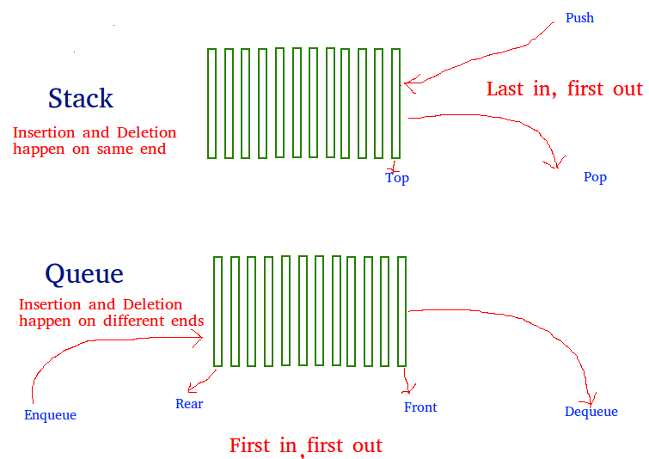
Practice Question 1:Implement Queue using Stacks
A queue can be implemented using two stacks. Let queue to be implemented be q and stacks used to implement q be stack1 and stack2

Slide 22
In this method, in en-queue operation, the new element is entered at the top of stack1. In de-queue operation, if stack2 is empty then all the elements are moved to stack2 and finally top of stack2 is returned.
ALGORITHM:
enQueue(q, x)
1) Push x to stack1 (assuming size of stacks is unlimited).
deQueue(q)
1) If both stacks are empty then error.
2) If stack2 is empty
While stack1 is not empty, push everything from stack1 to stack2.
3) Pop the element from stack2 and return it.

Slide 23
Question 2. Given a queue of integers, reverse it without help of any explicit stack or queue. You need to change in the given queue itself.

